Slide 1
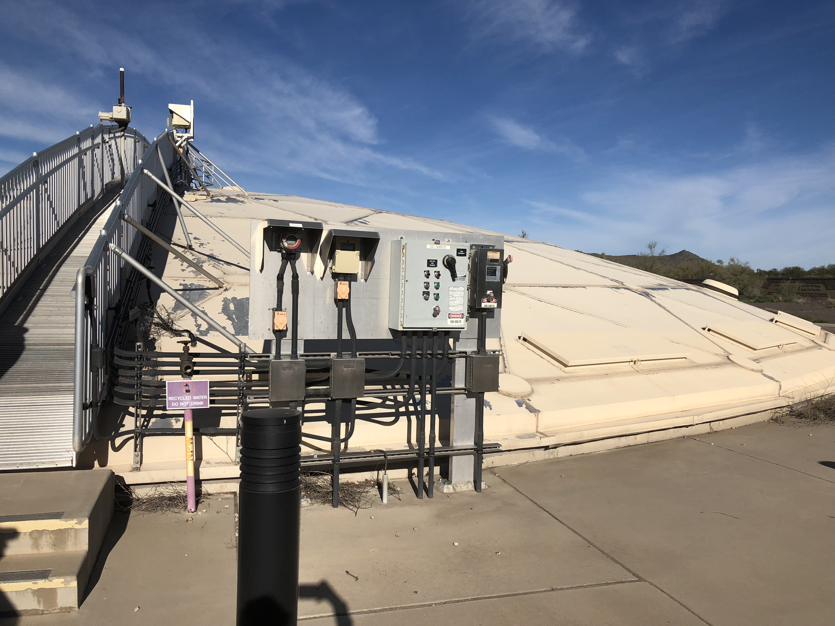
Cave Creek Water reclamation plant April 17, 2018
Water Environment federation student design competition
Katherine Dougherty
Hadley Habeck
Artem Lezhniuk
Hunter Stacy

Slide 2
Project Description
Cave Creek Water Reclamation Plant (CCWRP) is located in Phoenix, Arizona to serve the development north of the Central Arizona Project (CAP)
Purpose: Rehabilitate CCWRP to produce Class A+ reclaimed water and recharge by the reopening in 2025 to 2050
2009 Capacity: 8 million gallons per day (MGD)
Figure 1: NAU Team Picture at CCWRP by Dr. Dianne McDonnell

Slide 3
Project Objectives
Analysis of historic and predicted population, flow, and loading conditions of the CCWRP
Reevaluation of unit operations for optimization
Provide recommended effluent usage
Rehabilitate the CCWRP to meet the flow and loading capacities for 2025 through 2050
Table 1: Phasing Based on Flow Capacity from 2025 to 2050
Phasing | Flow Capacity
Phase 1: Existing | 8 MGD: Surpasses Reopening
Phase 2: 2025-2037 | 20 MGD: Anticipated Flow by 2037
Phase 3: 2037-2050 | 33 MGD: Anticipated Flow by 2050

Slide 4
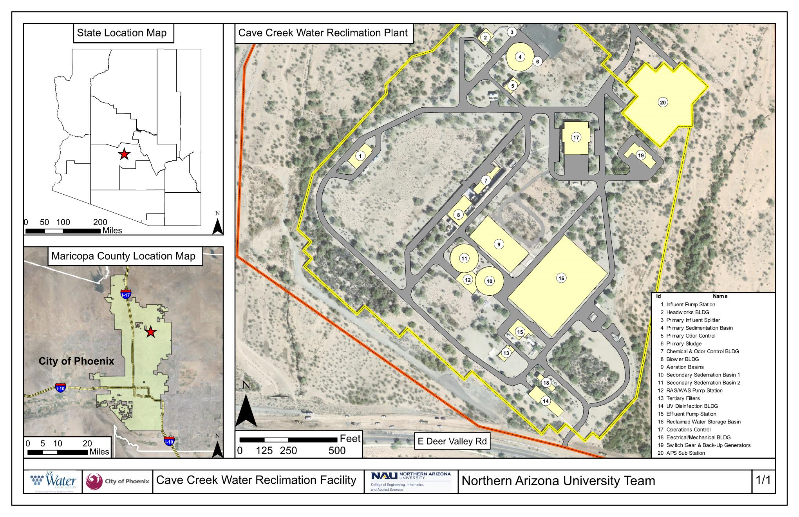

Slide 5
Historic flow and loading analysis
Table 2: CCWRP Historic Flow and Loading [1]
CCWRP 2008 Exiting Design Conditions: Flowrate and Loading
Sewershed Population | Conditions | Flowrate (Q) |  | COD* |  | TSS**
 |  | MGD | Gal/per/day | lbs/day | lb/gal | lbs/day | lb/gal
40,000 | First Phase Design Capacity | 8 | 200 | 32,000 | 0.004 | 13,300 | 0.002
 | Daily Average | 3.51 | 87.75 | 13,000 | 0.004 | 6,000 | 0.002
*COD = Chemical Oxygen Demand
**TSS = Total Suspended Solids

Slide 6
existing conditions
Grit and sludge is removed from the primary sedimentation basin and is sent back to the 91st Avenue Wastewater Treatment Plant (WWTP)
The CCWRP maintains a low profile, most operations are located underground
Figure 3: Unit Process Flow Diagram of Existing Plant

Slide 7
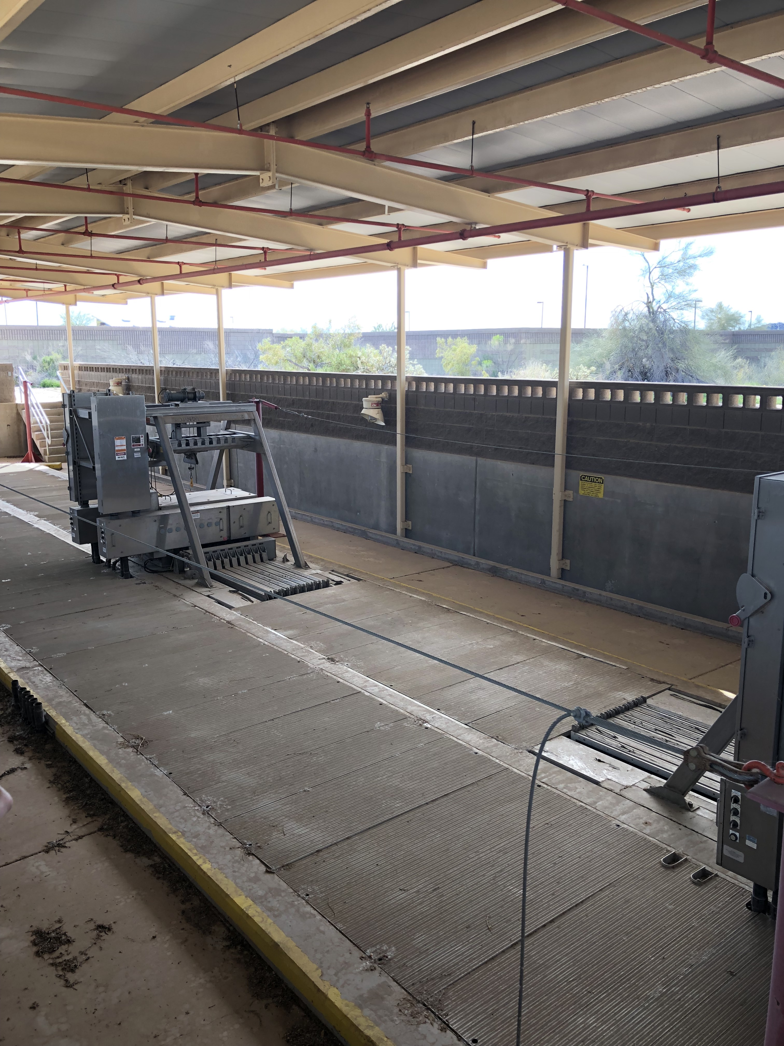
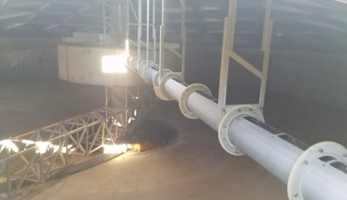
Problems with existing conditions
Large amount of grit build up causing increase ware on influent pumps
No grit removal system causing overloading in primary sedimentation basin
Insufficient UV disinfection due to operation and maintenance issues
High salinity from water softener backwash
Lack or absence of duplicate systems
Figure 4: UV Disinfection by Katherine Dougherty
Figure 5: Inside Primary Sedimentation Basin by Hunter Stacy

Slide 8
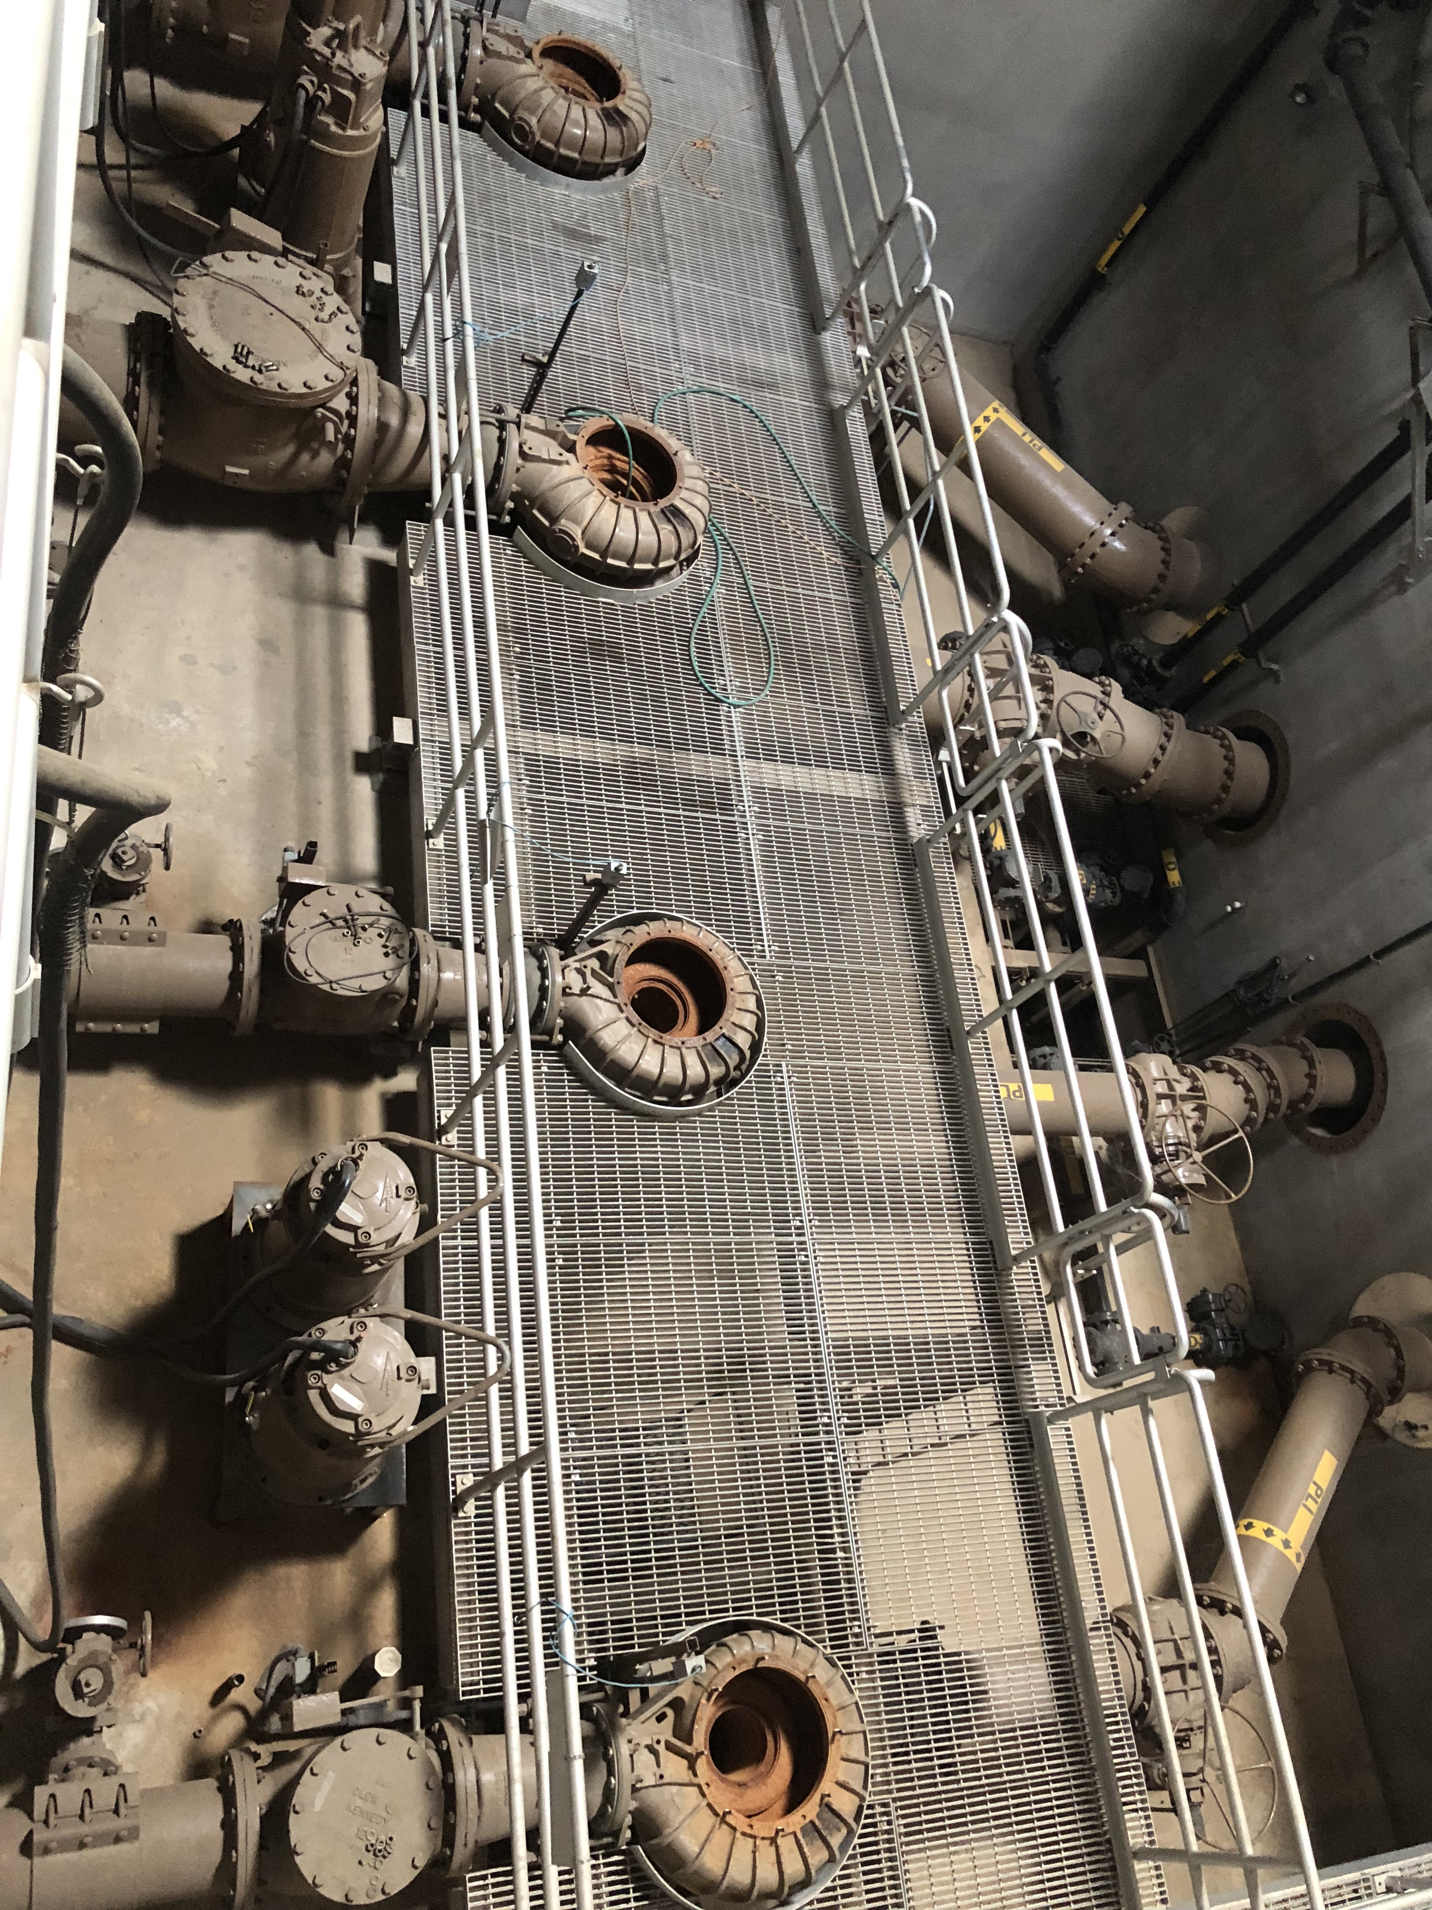
Existing Hydraulic analysis
The influent is being delivered via a 24-in diameter gravity-forced sewer collection system
Currently the influent is being pumped a vertical distance of 38-ft and horizontal distance of 800-ft within the plant
Total headloss across the gravity-forced part of the system is 28-ft

Slide 9
Population projections
Table 3: Population Estimates with Log and Percent Growth Measurements [2]
CCWRP Collection Area Population Projection
Year | City of Phoenix Population Estimate | Computed Population Estimate (Log Growth) | Computed Population Estimate (Percent Growth)
2019 | N/A | 75,300 | 75,300
2020 | 79,336 | 79,235 | 79,173
2025 | 116,664 | 97,026 | 96,179
2030 | 153,992 | 119,212 | 116,416
2040 | 223,939 | 175,130 | 162,530
2050 | 297,083 | 262,351 | 224,948

Slide 10
Projected flow and loading analysis
Table 4: CCWRP Future Flow and Loading Predictions [1], [3]
CCWRP Flow and Loading Phase Summary
Phase | Flow (MGD) | Year of Implementation | COD (lb/day) | BOD* (lb/day) | TSS (lb/day) | TDS** [4] (mg/L)
Phase 1 | 8 | Existing | 32,000 | 17,600 | 13,300 | 1,520
Phase 2 | 20 | 2025-2037 | 67,480 | 37,114 | 28,046 | 1,696
Phase 3 | 33 | 2037-2050 | 113,036 | 62,170 | 46,980 | 1,775
* BOD = Biological Oxygen Demand
** TDS = Total Dissolved Solids

Slide 11
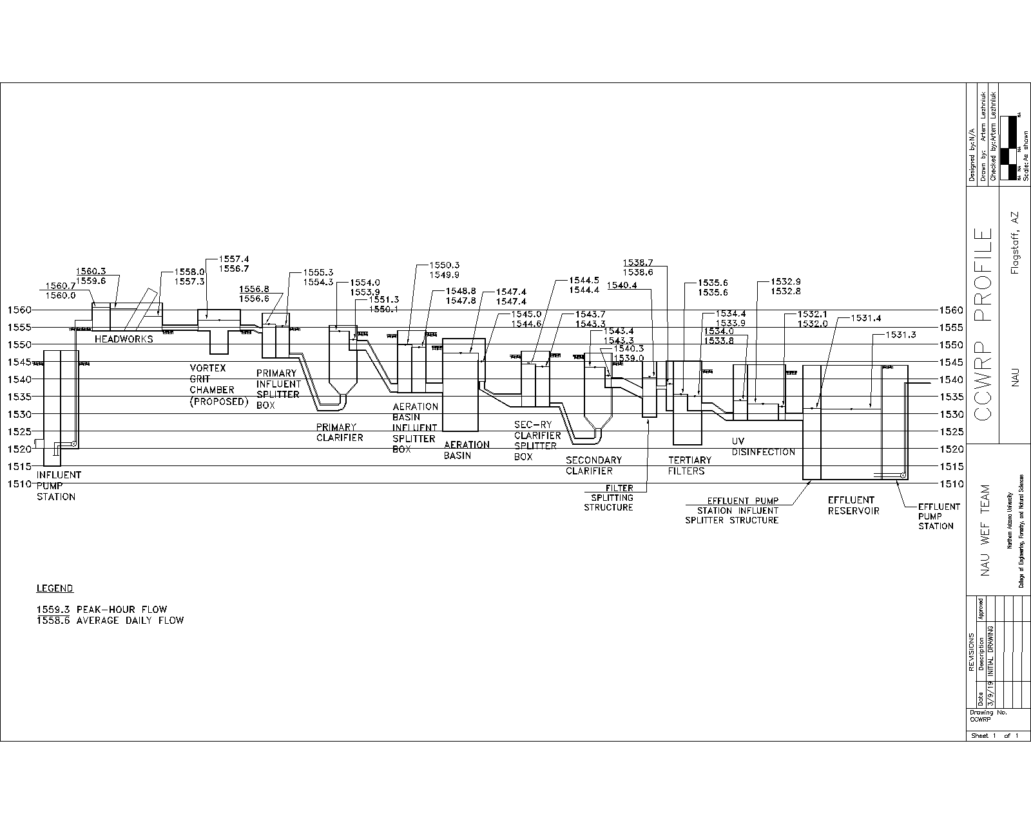
Proposed Hydraulics
Preliminary treatment improvements impacted the existing HGL due to the gravity-forced system
Influent pumps are required to produce a total head of 70-ft
Total headloss from headworks channel to primary splitter box 2.1-ft
Adding the grit removal and bar screens increases the headloss across the system by 1.5-ft, respectively
Solution: Headworks channel operating floor elevation should be increased by 2-ft to accommodate improvements and redundancy

Slide 12
Proposed hydraulic gradeline

Slide 13
Effluent Standards
Table 5: Effluent Usage Standards [4]
Effluent Usage Standards [4]
Designated Use | Coliform (cfu/100 ml) | Total Nitrogen (mg/L) | pH | TSS (NTU) | TDS (mg/L) [3]
Groundwater Recharge | 0 | 10 | - | - | 500-1,000
A+ Standard (Irrigation) | 23 | 10 | - | 2 | 500-2,000
Discharge into Source of Potable Water | 0 | 1.2-1.5 | 5.0-9.0 | 1 | -

Slide 14
Effluent usage analysis
Table 6: Effluent Usage Weighted Decision Matrix
Effluent Usage Weighted Decision Matrix
Criteria | Weight | Irrigation |  | Groundwater Recharge |  | Direct Potable Reuse
 |  | Raw Score | Weighted Score | Raw Score | Weighted Score | Raw Score | Weighted Score
Environmental Impact | 30% | 4 | 1.2 | 4 | 1.2 | 2 | 0.6
Feasibility / Constructability | 10% | 4 | 0.4 | 5 | 0.5 | 1 | 0.1
Maintenance and Operation | 15% | 3 | 0.45 | 3 | 0.45 | 1 | 0.15
Social Impact | 30% | 5 | 1.5 | 3 | 0.9 | 1 | 0.3
Economic Impact | 15% | 4 | 0.6 | 2 | 0.3 | 4 | 0.6
Total Score Out of 5 | 100% |  | 4.15 |  | 3.35 |  | 1.75

Slide 15
Design criteria for Treatment Improvements
Treatment Improvements include:
Influent Pump Station
Headworks
Grit Removal
Desalination
UV Disinfection
Solar Power
Treatment improvements were analyzed using a decision matrix with six criteria:
Process Efficiency
Feasibility and Constructability
Maintenance and Operation (O&M)
Staffing Levels
Economic Impact
Environmental and Social Impacts

Slide 16
Influent pump station
Problem
Requirements
Experienced erosion and clogging due to grit, rags, and horse hair
Overcome 70-ft of head
Solution
Options
Existing Centrifugal Pumps
Constantly deliver flow
High efficiency
Low maintenance
Centrifugal Pumps &Grinders
Heavy Duty Slurry Pumps
Replace existing with 12-Inch Eddy Heavy Duty Slurry Pump

Slide 17
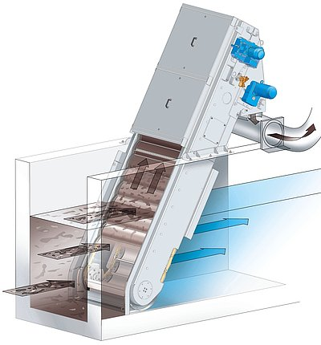
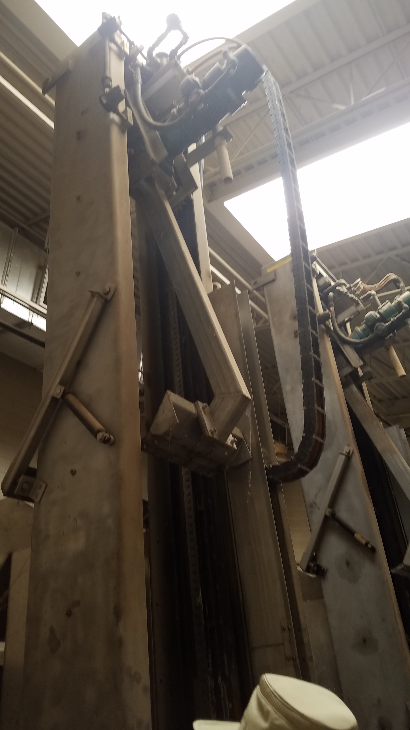
Headworks
Problem
Replace existing with EscaMax Perforated Bar Screens
Requirements
Experienced high wear from grit erosion and clogging
Maintain a channel velocity of 1.5 ft/s to 3 ft/s[6]
Solution
Options
Existing Bar Screens
Screening discharge to sewer caused sedimentation issues
Velocity through bars should not be less than or more than 2 ft/s and 3 ft/s [6]
Step Screens
EscaMax Perforated Bar Screens
Figure 7: Existing Bar Screen by Hunter Stacy
Figure 8: EscaMax Bar Screen [5]
Figure 9: Solid Waste Conveyer by Hunter Stacy

Slide 18
Grit Removal
Problem
Implement the Vortex Grit Chamber
Requirements
No existing system
95% efficiency removal
Solution
Options
Existing Process
Aerated Grit Chamber
Vortex Grit Chamber
Accumulated in primary sedimentation basin causing overloading on scrapper
Primary basin shutdowns for maintenance
Minimual headloss
Easily implemented into exisitng facility
Figure 10: HUBER Technology Vortex Grit Chamber [7]
Figure 11: Existing Primary Sedimentation Basin by Katherine Dougherty

Slide 19
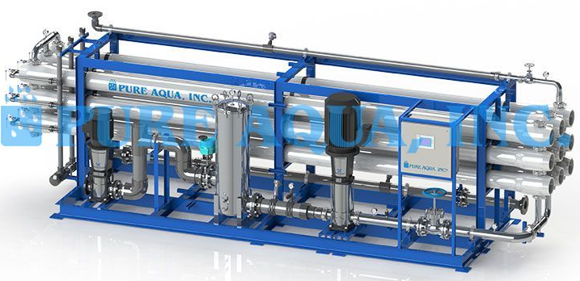
Desalination
Problem
Divert % of flow through PureAqua RO system
Requirements
High levels of salinity limit effluent use options
Reduce TDS to below 1,000 mg/L
Solution
Options
Reverse Osmosis(RO), distillation, de-ionization
Figure 12: JW Marriot Golf Course, which experienced browning due to high salinity in CCWRP effluent [8]
Figure 13: R.O.- PureAqua TW-900K-18780 system [9]

Slide 20
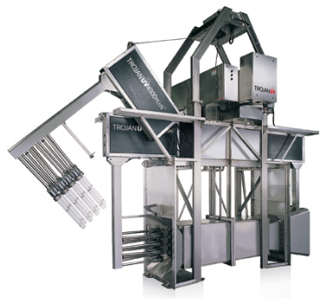
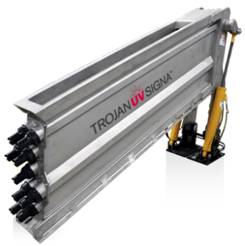
UV Disinfection
Problem
Retrofit Trojan UV Signa in existing channel
Requirements
UV bulbs filling with water, breaking, and lowering disinfection capabilities
Disinfect effluent stream
Solution
Options
Continue with existing system
Reduce energy demand
Trojan UV 4000+
Trojan UV Signa
Figure 14: Trojan UV 4000+ [10]
Figure 15: Trojan UV Signa [10]
Figure 16: Existing UV System by Hunter Stacy

Slide 21
Solar POWER Feasibility
Problem
Implement solar power array north of APS substation
Requirements
High electrical usage and cost
Reduce electrical usage from the grid
Solution
Options
Continue to pull power from the APS grid
Implement solar power array

Slide 22
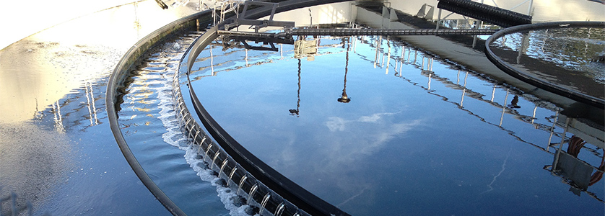
Summary of Selected Improvements
Influent Pump Station
Eddy12-Inch Heavy Duty Slurry Pumps
Headworks
EscaMax Perforated Bar Screen
Grit Removal
Hubber Technology Vortex Grit Chamber
Primary Clarification to Tertiary Treatment
Duplicate Existing Systems
Disinfection and Water Quality
RO Desalination
Trojan UV Signa Disinfection
Solar Panel Array
400W Panels
19.3% efficiency
Figure 16: City of Henderson Wastewater Treatment Plant by Hunter Stacy

Slide 23
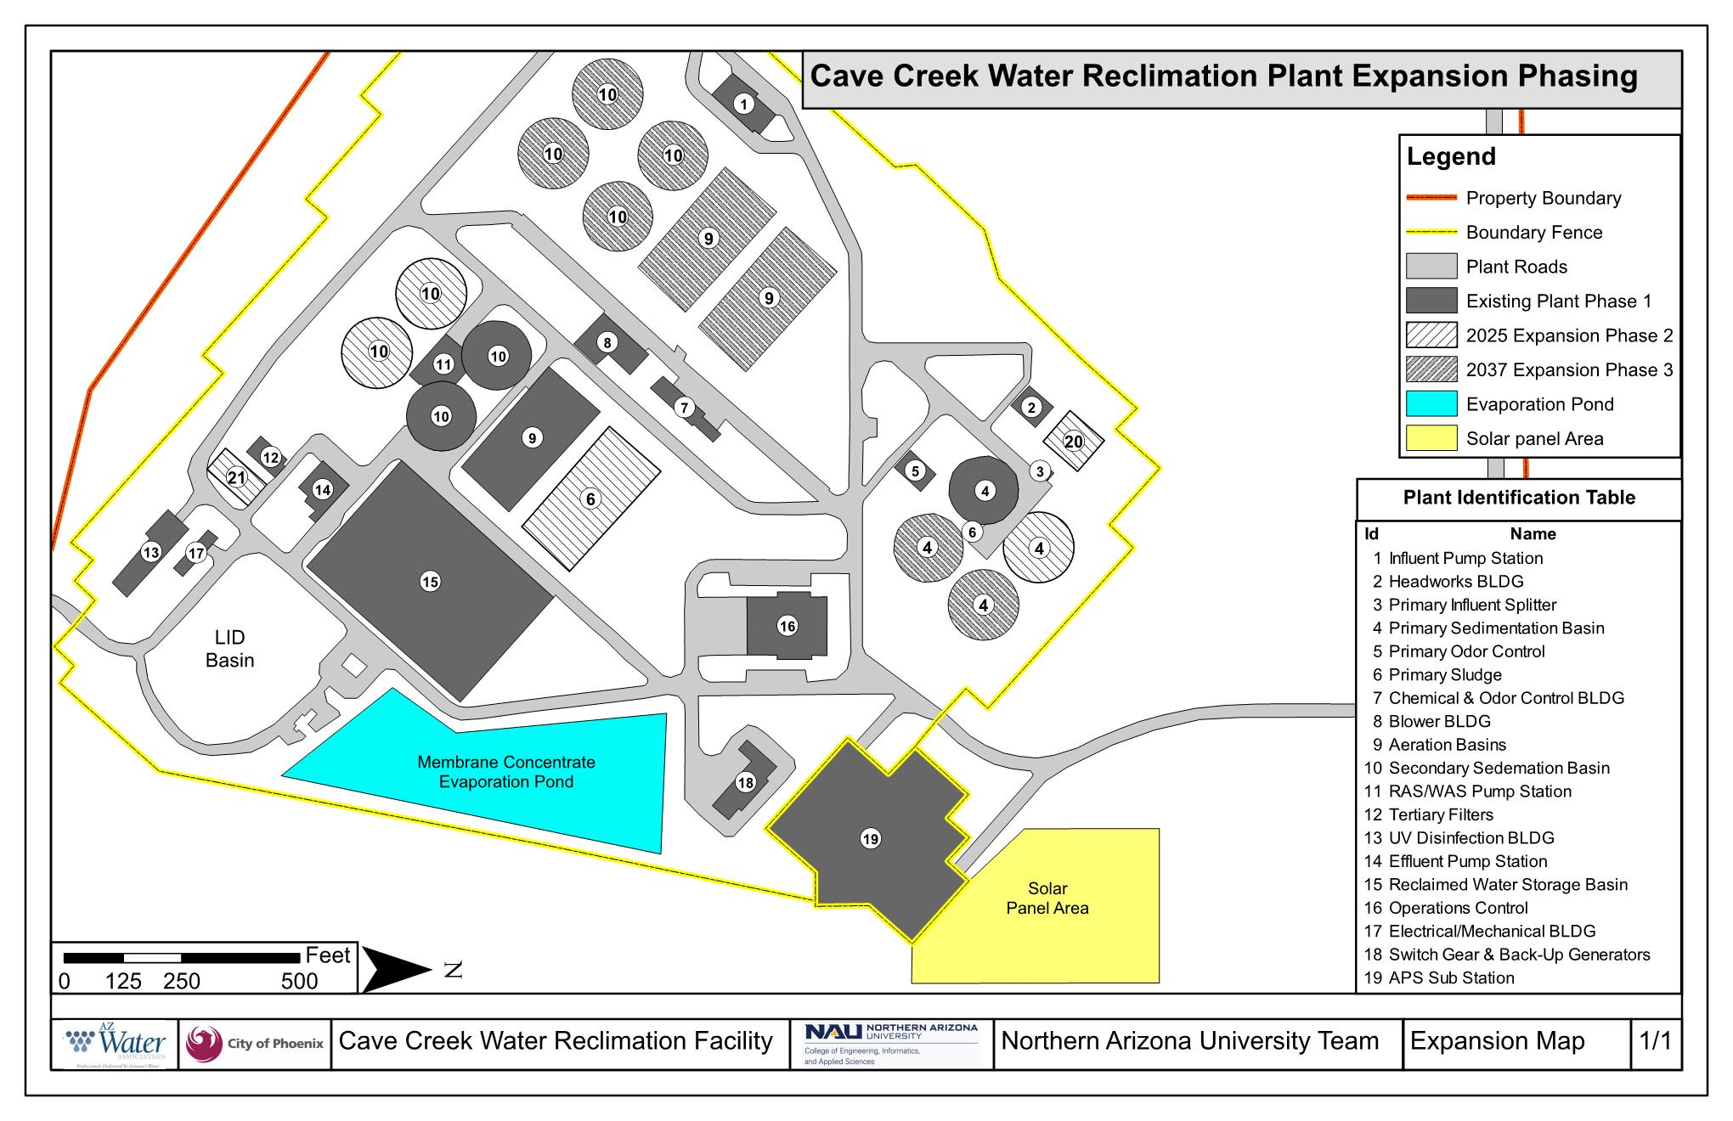

Slide 24
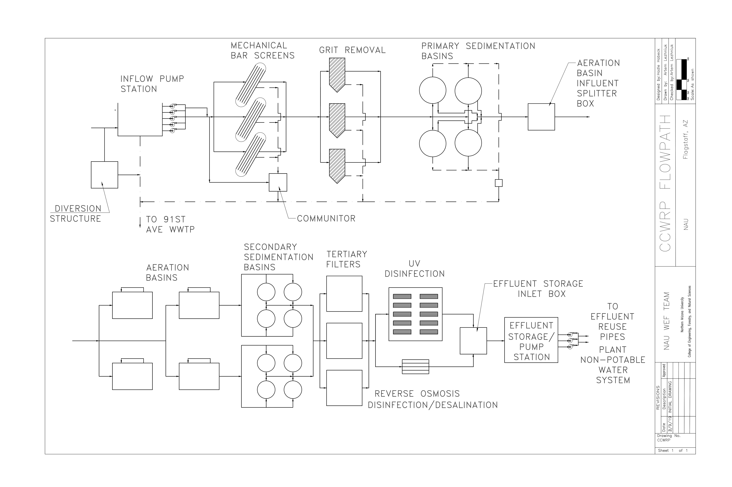

Slide 25
Construction and Phasing Totals
Table 7: Expansion Phasing
Unit Process | Phase 1 | Phase 2 | Phase 3
Years of Operation | Existing 2002 - 2025 | Reopening in 2025 - 2037 | 2037 - 2050
Pump Station | 4 Centrifugal Pumps | 3 12" Slurry Pumps | 5 12" Slurry Pumps
Screening | 2 Bar Screens | 2 New Bar Screens | 4 Bar Screens
Grit Removal | Nonexistent | 2 Vortex Grit Chambers | 3 Vortex Grit Chamber
Primary Sedimentation Basin | 1 Basin | 3 Basins | 4 Basins
Aeration Basin | 1 Basin | 3 Basins | 4 Basins
Secondary Sedimentation Basin | 2 Basins | 5 Basins | 7 Basins
Tertiary Filter | 1 Filter | 2 Filters in Parallel | 3 Filters in Parallel
UV Disinfection | 1 UV System | 7 Banks | 9 Banks
Desalination | Nonexistent | 11 Systems | 19 Systems
Solar Panels | Nonexistent | 3,400 Panels | 4,400 Panels

Slide 26
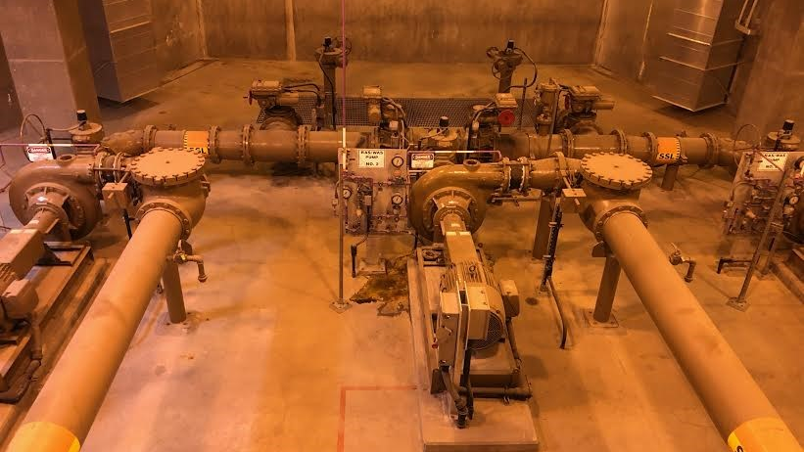
Proposed staffing levels
Total Number of Employees: 16 [11]
Weekday: 12 Employees
08:00-16:00 – 9 Employees
16:00-24:00 – 2 Employees
24:00-08:00 – 1Employees
Weekend: 4 Employees
08:00-16:00 – 2 Employees
16:00-24:00 – 1Empolyees
24:00-08:00 – 1Employees

Slide 27
Improvement Cost
Table 8: Cost of Engineering Design Services
Summary of CCWRP Estimated Construction Cost (USD*)
Criteria | Phase 2 - 2025 | Phase 3 - 2037
Design Costs | 69,145 | -
Capital Costs | 95,091,504 | 73,471,133
General Contractor Costs | 34,521,246 | 29,866,493
Sub-Contractor Costs | 10,356,374 | 8,959,948
Contingency | 32,403,187 | 25,834,407
Total Cost | 172,441,456 | 138,131,981
*USD = United States Dollars

Slide 28
Operation and maintenance cost
Table 9: CCWRP Annual Estimated Operations and Maintenance Cost
CCWRP Yearly Operations and Maintenance Cost (USD)
Unit | 2025 Value | Initial Maintenance | Annual Additional Maintenance | Total Annual Maintenance
Influent Pump Station | 419,112 | 31,433 | 2,619 | 34,053
Headworks Building | 569,861 | 42,740 | 3,562 | 46,301
Grit Removal | 625,683 | 46,926 | 3,911 | 50,837
Primary Clarifiers | 604,190 | 45,314 | 3,776 | 49,090
Aeration Basins | 35,821,569 | 895,539 | 74,628 | 970,167
Secondary Clarifiers | 1,260,919 | 94,569 | 7,881 | 102,450
Tertiary Filters | 2,383,328 | 178,750 | 14,896 | 193,645
UV Disinfection | 1,437,639 | 107,823 | 8,985 | 116,808
Desalination | 5,253,830 | 394,037 | 32,836 | 426,874
Solar Power | 6,131,459 | 306,573 | 25,548 | 332,121
Total Annual Maintenance |  |  |  | 2,322,346

Slide 29
Projected savings
Table 10: CCWRP yearly solar power electricity savings
CCWRP Solar Power Yearly Electrical Savings
Criteria | Phase 2 | Phase 3
Number of panels | 3,400 | 4,400
Watts/panel | 400 | 400
Efficiency (%) | 0.15 | 0.15
Hours of operation (hr/day) | 12 | 12
Wh/day | 2,448,000 | 3,168,000
kwh/day | 2,448 | 3,168
kwh/year | 820,080 | 1,156,320
$/year | $ 410,040 | $ 867,240
Electricity rate ( $0.50/kWh )
Includes cost of electricity, taxes and other mark-ups from APS and governing agencies
Watt hours per day calculation
Wh/day = Panels * W/Panel * eff. * hr/day
Electrical savings per year
$/year = $0.50/kWh* kWh/day* 365 days

Slide 30
Conclusion
PROBLEMS
Clogging of pumps
SOLUTIONS
Replace existing with new slurry pump
Vortex grit removal
BENEFITS
Improve process efficiency
Innovative improvements
Grit build up in primary clarifier
Insufficient UV disinfection
High salinity of effluent
Lack of duplicate systems
High energy usage
Replace exiting with Trojan UV Signa
Duplicate & redundant systems
Divert % of flow through RO
Solar panel array

Slide 31
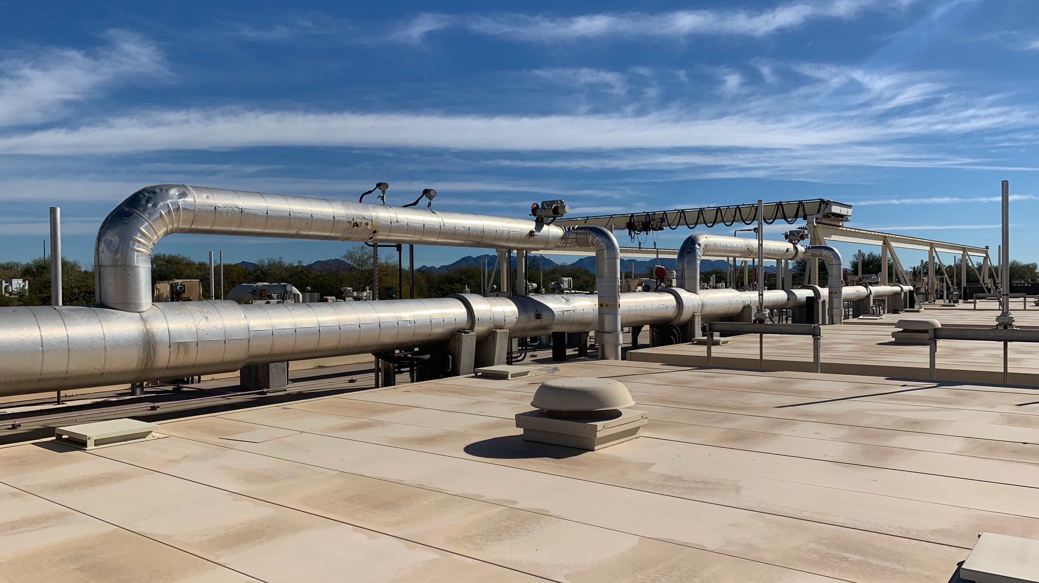
Recommendations
Onsite grit and sludge treatment
Require pretreatment for highly concentrated point sources of salinity
Stockpile excavation tailings from Phase 2 and Phase 3
Onsite equalization basin
Onsite evaporation pond
Direct potable reuse

Slide 32
References
[1] “Cave Creek WRP: General Information.” Jan-2019.
[2] “How do you calculate population growth? + Example,” Socratic.org. [Online]. Available: https://socratic.org/questions/how-do-you-calculate-population-growth.
[3] Central Arizona Salinity Study - Phase II Salinity Control in Waste Water Treatment Plants.” Bureau of Reclamation, Sep-2006.
[4] Department of Environmental Quality, “Arizona Administrative Code: Title 18 Environmental Quality, Chapter 09: Water Pollution Control.”
[5] “Perforated Plate and Bar Screens.” [Online]. Available: https://www.huber-technology.com//products/screens-and-fine-screens/perforated-plate-and-bar-screens.html. [Accessed: 08-Apr-2019].
[6]“Preliminary Treatment: Bar Screens.” Islamic University of Gaza.
[7] HUBER Technologu, "HUBER Vortex Grit Chamber VORMAX," 26 March 2019. [Online]. Available: http://www.huber-technology/com/products/grit-seperation-and-treatment/circular-grit-traps/huber-vortex-grit-chamber-vormax.html. [Accessed 13 April 2019].
[8] “Wildfire Golf Club | Award Winning Golf Course | The Club at Desert Ridge.” [Online]. Available: https://www.theclubjwdesertridge.com/golf. [Accessed: 13-Apr-2019].
[9] “Industrial Brackish RO System: RO-500.” Pure Aqua.
[10]“TrojanUVSigna - TrojanUV.” [Online]. Available: https://www.trojanuv.com/products/wastewater/trojanuvsigna. [Accessed: 08-Apr-2019].
[11] “Estimating Staffing for Municipal Wastewater Treatment Facilities| NEPIS | US EPA,” 1973. [Online]. Available: https://nepis.epa.gov/Exe/ZyPDF.cgi/9100W7EU.PDF?Dockey=9100W7EU.PDF [Accessed: 08-Apr-2019].

